Slide 1

RESTAURANT CHAIN
RELATIONAL DATABASE
Code First Girls Final Project 2022
Created by: K. Bugaite

Slide 2

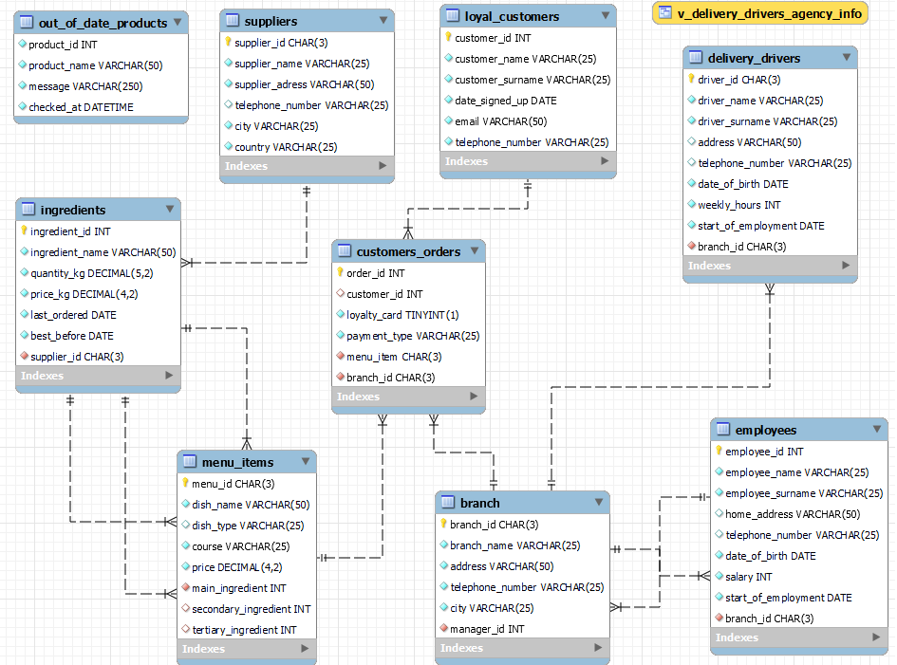
RESTAURANT CHAIN EER DIAGRAM

Slide 3

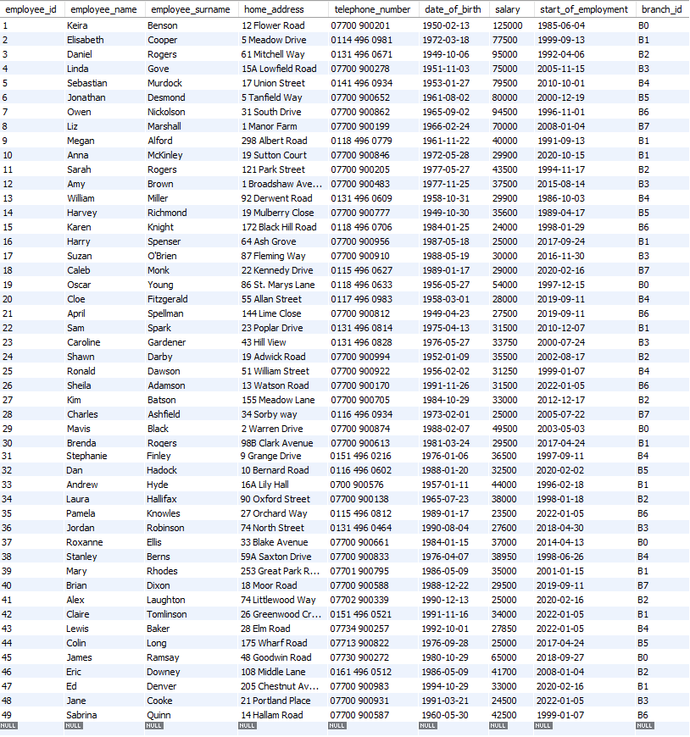
EMPLOYEES TABLE:
CREATE TABLE IF NOT EXISTS Employees(
employee_id INT NOT NULL,
employee_name VARCHAR(25) NOT NULL,
employee_surname VARCHAR(25) NOT NULL,
home_address VARCHAR(50),
telephone_number VARCHAR(25),
date_of_birth DATE NOT NULL,
salary INT NOT NULL,
start_of_employment DATE NOT NULL,
branch_id CHAR(3) NOT NULL,
CONSTRAINT PK_employee_id PRIMARY KEY (employee_id)
);

Slide 4
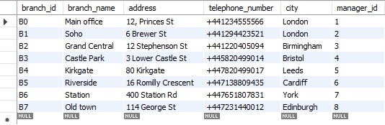
BRANCH TABLE:
CREATE TABLE IF NOT EXISTS BRANCH(
branch_id CHAR(3) NOT NULL,
branch_name VARCHAR(25) NOT NULL,
address VARCHAR(50) NOT NULL,
telephone_number VARCHAR(25) NOT NULL,
city VARCHAR(25) NOT NULL,
manager_id INT NOT NULL,
CONSTRAINT PK_branch_id PRIMARY KEY
(branch_id)
);

Slide 5
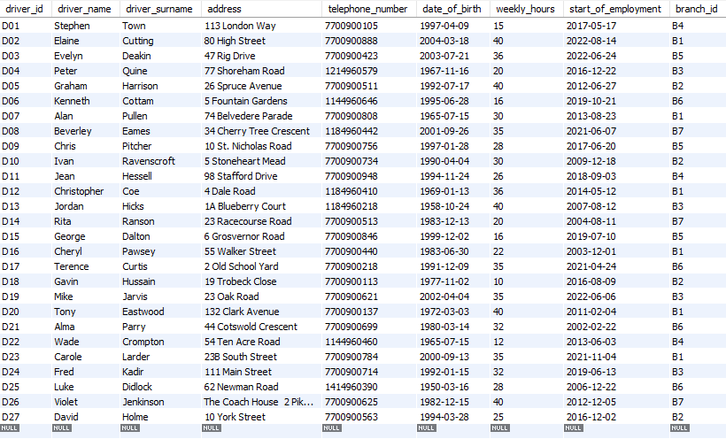
DELIVERY DRIVERS TABLE:
CREATE TABLE IF NOT EXISTS Delivery_drivers(
driver_id CHAR(3) NOT NULL,
driver_name VARCHAR(25) NOT NULL,
driver_surname VARCHAR(25) NOT NULL,
address VARCHAR(50),
telephone_number VARCHAR(25),
date_of_birth DATE NOT NULL,
weekly_hours INT NOT NULL,
start_of_employment DATE NOT NULL,
branch_id CHAR(3) NOT NULL,
CONSTRAINT PK_driver_id PRIMARY KEY (driver_id)
);

Slide 6
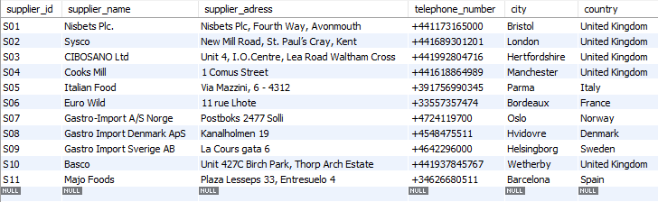
SUPPLIERS TABLE:
CREATE TABLE IF NOT EXISTS Suppliers(
supplier_id CHAR(3) NOT NULL,
supplier_name VARCHAR(25) NOT NULL,
supplier_address VARCHAR(50) NOT NULL,
telephone_number VARCHAR(25),
city VARCHAR(25) NOT NULL,
country VARCHAR(25) NOT NULL,
CONSTRAINT PK_supplier_id PRIMARY KEY (supplier_id)
);

Slide 7
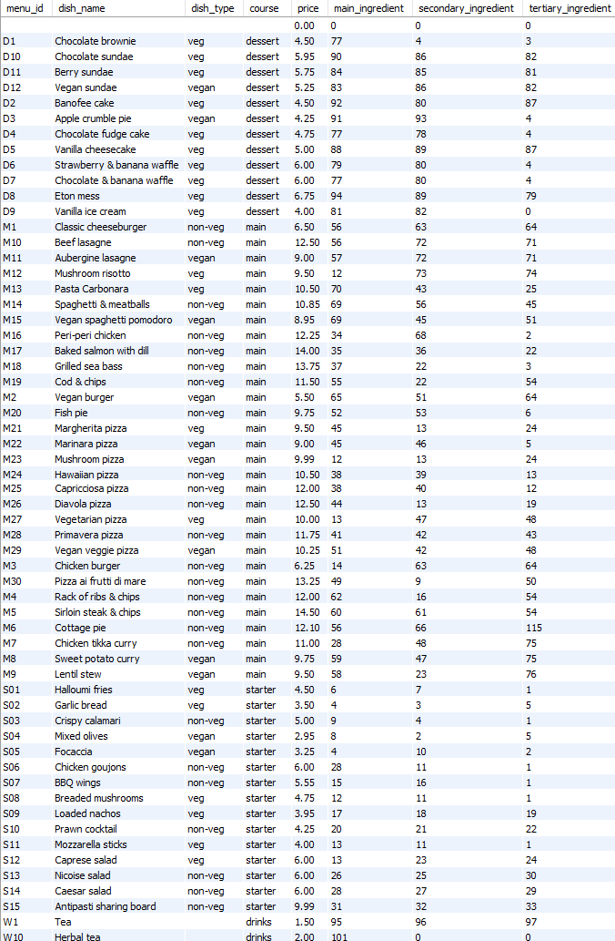
MENU ITEMS TABLE:
CREATE TABLE IF NOT EXISTS menu_items(
menu_id CHAR(3) NOT NULL,
dish_name VARCHAR(50) NOT NULL,
dish_type VARCHAR(25),
course VARCHAR(25) NOT NULL,
price DECIMAL(4,2) NOT NULL,
main_ingredient INT NOT NULL,
secondary_ingredient INT,
tertiary_ingredient INT,
CONSTRAINT PK_menu_id PRIMARY KEY (menu_id)
);

Slide 8
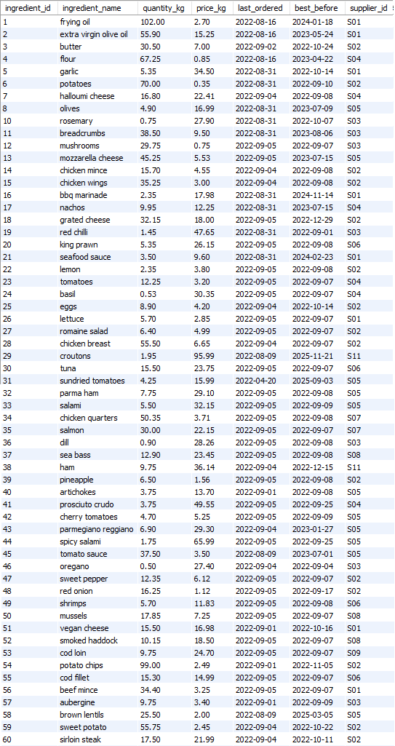
INGREDIENTS TABLE:
CREATE TABLE IF NOT EXISTS Ingredients(
ingredient_id INT NOT NULL,
ingredient_name VARCHAR(50) NOT NULL,
quantity_kg DECIMAL(5,2) NOT NULL,
price_kg DECIMAL(4,2) NOT NULL,
last_ordered DATE NOT NULL,
best_before DATE NOT NULL,
supplier_id CHAR(3) NOT NULL,
CONSTRAINT PK_ingredientr_id PRIMARY KEY (ingredient_id)
);

Slide 9
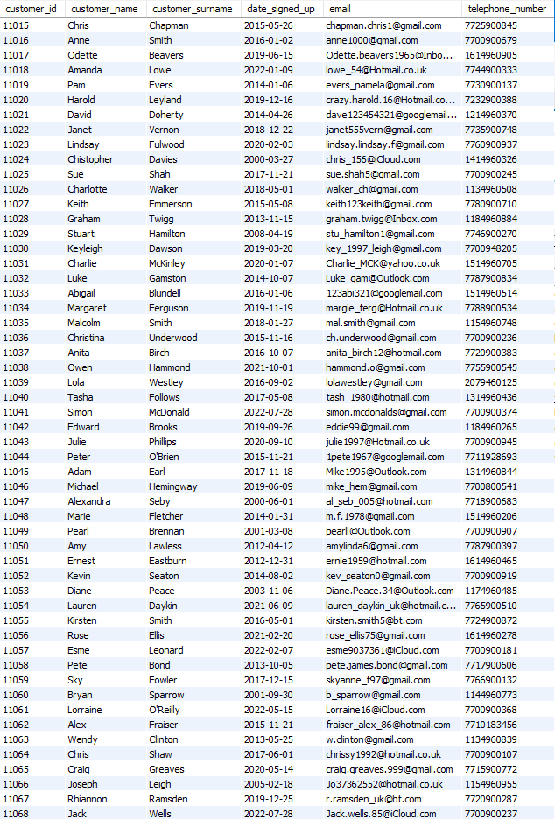
LOYAL CUSTOMERS TABLE:
CREATE TABLE IF NOT EXISTS Loyal_customers(
customer_id INT NOT NULL,
customer_name VARCHAR(25) NOT NULL,
customer_surname VARCHAR(25) NOT NULL,
date_signed_up DATE NOT NULL,
email VARCHAR(50) NOT NULL UNIQUE,
telephone_number VARCHAR(25) NOT NULL UNIQUE,
CONSTRAINT PK_customer_id PRIMARY KEY (customer_id)
);

Slide 10
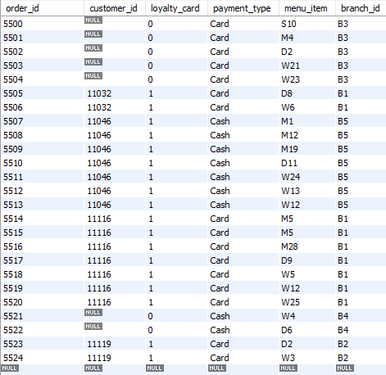
CUSTOMERS ORDERS TABLE:
CREATE TABLE IF NOT EXISTS customers_orders(
order_id INT NOT NULL,
customer_id INT,
loyalty_card BOOLEAN NOT NULL,
payment_type VARCHAR(25) NOT NULL,
menu_item CHAR(3) NOT NULL,
branch_id CHAR (3) NOT NULL,
CONSTRAINT PK_order_id PRIMARY KEY (order_id)
);

Slide 11
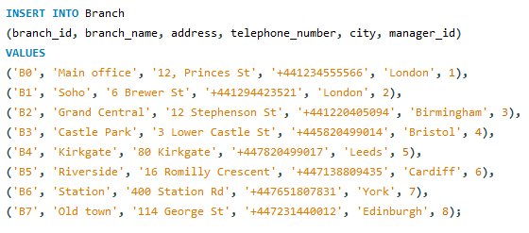
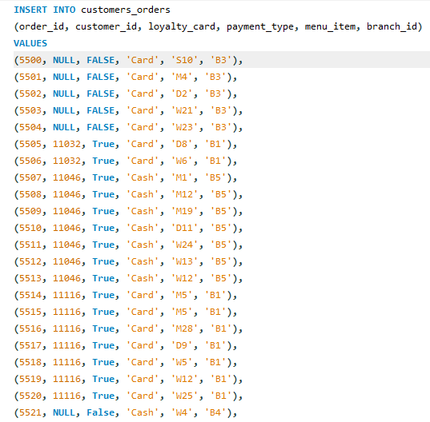
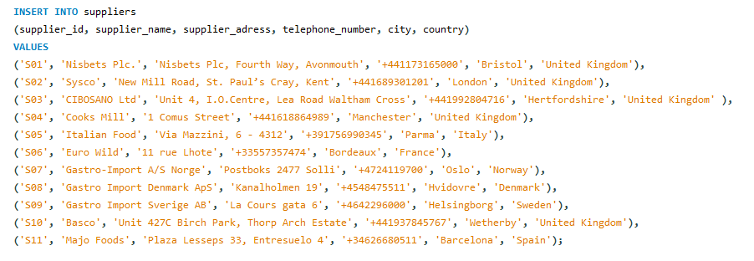
MANUALLY INSERTED THESE VALUES:
Other values inserted from CVS file as they had too many rows

Slide 12
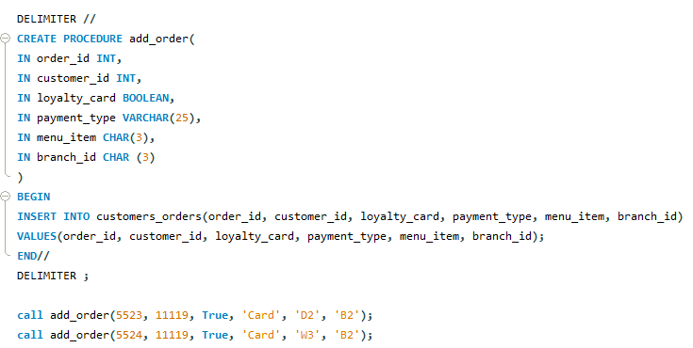
PROCEDURE that automatically inserts relevant information into 'customers_orders' table after each order is made.
It could be implemented to automate check out process.

Slide 13
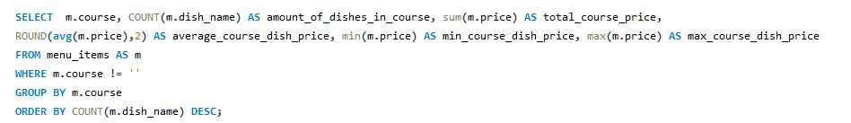

Analysis of the menu Courses by using COUNT, SUM, MAX, MIN in-built functions with GROUP BY course and ORDER BY Course with highest amount of items to choose from (main dishes in this case).
I had to use WHERE m.course != ' ' as there was one empty field showing up to omit it from analysis results.

Slide 14
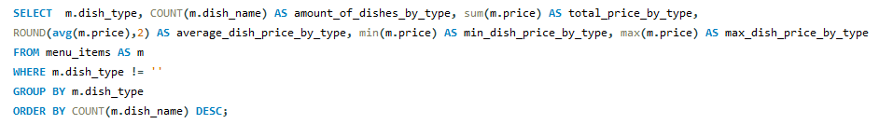

Now instead of analysing menu by Courses, we use Type of each dish if it has it assigned and analyse it by the same conditions.
'non-veg' = non vegetarian, 'veg' = vegetarian, 'vegan' = vegan
Drinks do not fall into any of the categories.

Slide 15
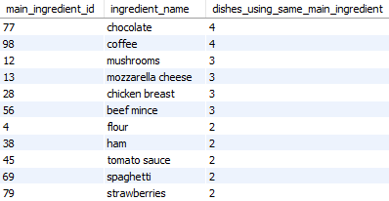
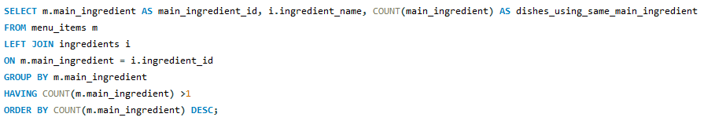
Analysis of dishes which use the same main ingredient
We show the ingredient's name by using LEFT JOIN from 'Ingredients' table.
We use HAVING clause to omit results of ingredients used in only 1 recipe and we order our results by ingredients used in highest amount of recipes.

Slide 16
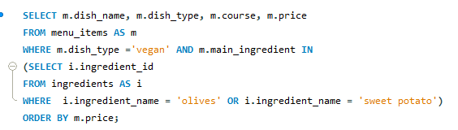

QUERY WITH A SUBQUERY - in this example customer is only looking for vegan dishes which have olives or sweet potatoes as their main ingredients.

Slide 17
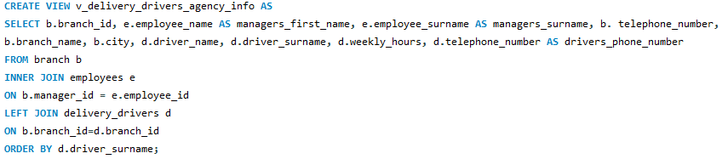
A VIEW that uses INNER JOIN which connects 'Branch' and 'Employees' tables.
It shows first and last names of Managers in charge of each branch without showing any of their personal data.
Then it uses a LEFT JOIN which connects each Branch and it's Manager and their work numbers while listing all of the delivery drivers working for each branch and their details.
A view like this could be used by an outsourcing agency that employs drivers. For convenience it's ordered by driver's surname alphabetically.

Slide 18
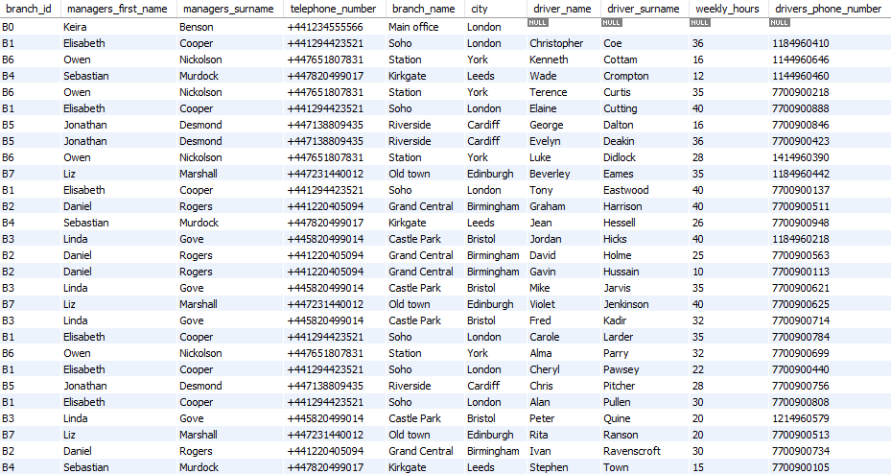
VIEW delivery_drivers_agency_info RESULTS

Slide 19
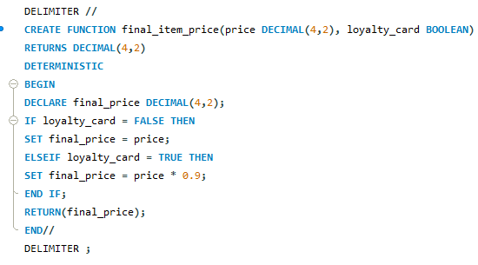
FUNCTION - Calculates the final price of each item ordered and gives customer a discount only if they present a loyalty card.

Slide 20
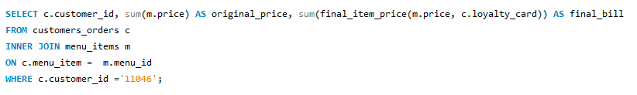

INNER JOIN - allows us to specify a customer by using their ID in WHERE clause to filter only for that specific customer's orders.
A user defined 'final_item_price' FUNCTION calculates each item's price with a 10% discount if that customer has presented a loyalty card and in-built SUM function calculates total amount this customer needs to pay.

Slide 21
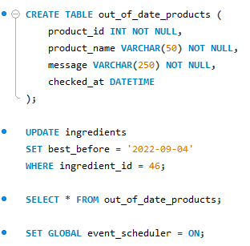
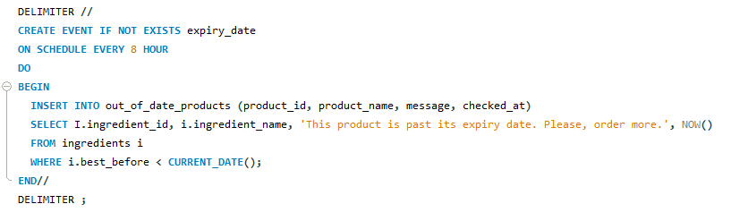

EVENT - this event checks the ingredients table for items which are past their best before date at the start of every shift - every 8 hours.
It notes which item it is with its ID and provides a timestamp when this event checked the database.

Slide 22
THANK YOU FOR YOUR ATTENTION!

